Slide 1
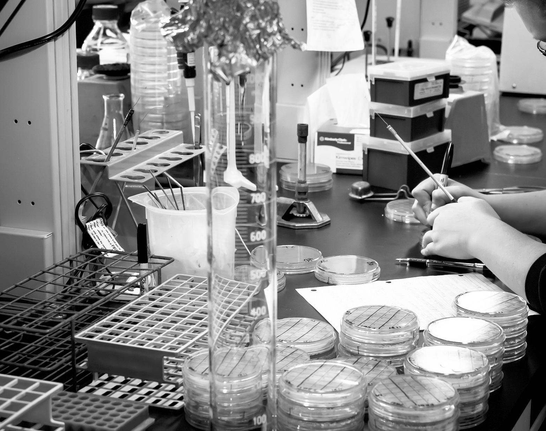

Supporting COVID-19 Vaccine Access through APVAX
December 2020
Strategy and Policy Department

Slide 2


APVAX
A structured framework for COVID-19 vaccine support
for developing member countries (DMCs)
Timely • Safe • Effective
$9 billion resource envelope
with country-specific allocations, accessible in line with DMC readiness
Platform for partner coordination
and knowledge sharing on vaccine program implementation as our understanding of what works—and what doesn’t—evolves through global experience

Slide 3




REQUIREMENTS Any DMC can access APVAX if it meets certain criteria.
Demonstrated adverse impact of COVID-19
Health, economic, social, or combination
Needs assessment and allocation plan
Completion of vaccine needs assessment and national vaccination allocation plan
Development partner coordination mechanism
Platform must be present, with a clear role for ADB within this platform

Slide 4


CRITERIA FOR VACCINES APVAX’s strict eligibility criteria will promote vaccine safety and effectiveness.
Has been selected for procurement via COVAX on behalf of its participating countries.
Manufacturer prequalified by WHO
Authorized by an SRA for manufacture in SRA country or SRA has authorized its manufacture in a non-SRA country.
OR
OR
Vaccines procured under the COVAX Facility must be prequalified by the World Health Organization (WHO) or at least have marketing authorization from a Stringent Regulatory Authority (SRA). If acceptable to the receiving country, emergency use listing by the WHO may be acceptable on an exceptional basis.

Slide 5
How do individual countries use APVAX?

Slide 6



RAPID RESPONSE COMPONENT
Timely and focused financing for vaccine access in the areas of vaccine procurement and logistics costs
Diagnostic and analytical work to prepare for vaccinations, payments to COVAX, procurement of vaccines, and logistics related to bringing vaccines from place of purchase to the DMC
Advance financing for quick disbursing support, streamlined project documentation and balanced due diligence

Slide 7




PROJECT INVESTMENT COMPONENT Flexible financing for wider range of vaccine access needs
Systems for distribution, delivery, and administration of vaccines
Physical infrastructure for vaccine delivery and distribution (cold-chain storage and transportation, vehicles, processing facilities)
Vaccine manufacturing capacity (expansion or establishment)
Training and capacity support for health workers, public communications and outreach, surveillance systems to monitor and track implementation progress
The project investment component can also support vaccine procurement, where additional ADB support and oversight is deemed beneficial.

Slide 8
PARTNERSHIP AND GOVERNMENT COMMITMENT A governor’s letter should be attached to a DMC’s APVAX proposal, containing:
Government’s commitment to implement its COVID-19 vaccination allocation plan
Arrangements and planning to manage incremental medical waste and procurement
Financing needs
DMC’s commitment to following the APVAX eligibility criteria and indicating selected vaccines or vaccine candidates

Slide 9
ADDITIONAL FINANCIAL RESOURCES To ensure DMC’s can invest in vaccines without disrupting planned investment pipelines, APVAX provides additional resources for each DMC above their regular country allocation.
$6.8 billion in additional regular OCR $1.9 billion in concessional OCR Additional grants are also being made available from ADB’s Disaster Response Facility.
Individual country ceilings:
Based on the estimated cost of vaccinating 70% of population (herd immunity)
ADB adopts a 30% burden share for concessional assistance countries and 20% for regular OCR-only countries
Additional resources available for commitment for 3 years

Slide 10
Procurement
Where procurement risks are low, ADB may, at the borrower’s request, agree to accredit the executing and/or implementing agencies and rely on the use of country procurement systems.
A DMC may undertake direct procurement of vaccines meeting ADB eligibility criteria, provided value for money is established and commercial terms and conditions are verified as reasonable.
Direct contracting will be subject to prior review. All other procurement shall be subject to post-review sampling unless ADB considers, on a case-by-case basis, that ADB oversight is desirable given the inherent level of procurement risk.

Slide 11
Group C countries, Georgia – Lending Terms
Eligible Amount - $15 million APVAX allocation for Georgia
$15 million maximum for vaccines procurement under Rapid Response Component (RRC)
Can draw on additional allocation from OCR country allocation for Project Investment Component (PIC)
Interest Rate - 50 basis points over LIBOR, a rebate or surcharge reflecting the cost of funds;
Maturity - A term of 10 years including a grace period of up to 3 years;
Commitment Charge - 15 basis points per year on the undisbursed loan balance;
Processing Timeline – Proposed processing timeline April – July 2021

